Slide 1



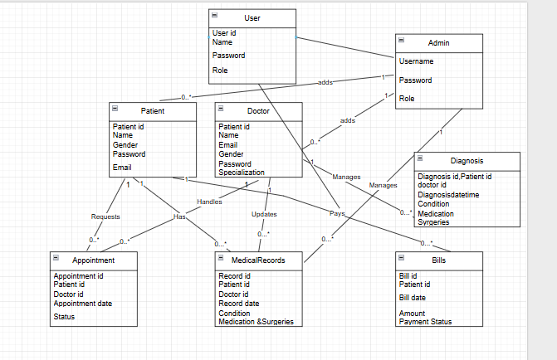

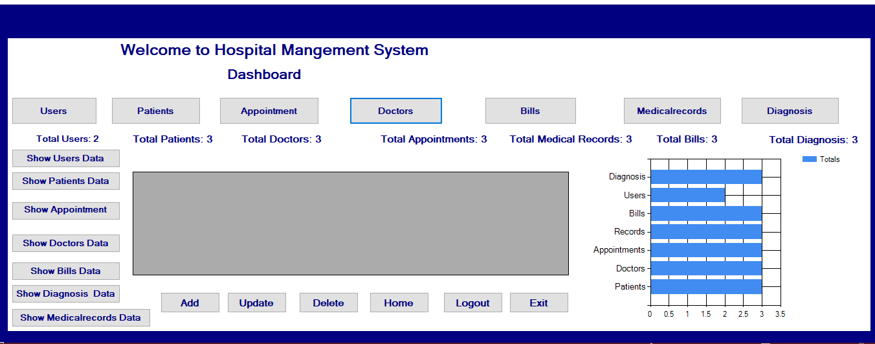






Hospital Management System
Name: Rabeel Fatima( Reg no:Sp23-BSE-032)
Instructor: Sir Umar Rasheed
Department: Computer Science
1.Introduction to HMS
2.ERD Diagram
Simple and user-friendly hospital management system
Reduces manual work
Speeds up hospital tasks
Manages doctors, patients, appointments, and records,
bills,diagnosis.
3.Dashboard
4.Entities
Doctor
Appointment
Patient
Bills
Admin
Medical Records
5.Functional Requirements
6.System Setup
7.Conclusion
Admin: Full control (manage doctors, patients, appointments, records, bills, dashboard).
Doctor: View medical records, suggest medications/surgeries, no add/delete control.
Patient: Cannot login, only pays bills (status updated by admin).
Platform:
C# Windows Forms Database: SQL Server
The HMS streamlines hospital tasks and improves patient care efficiently.

